Slide 2
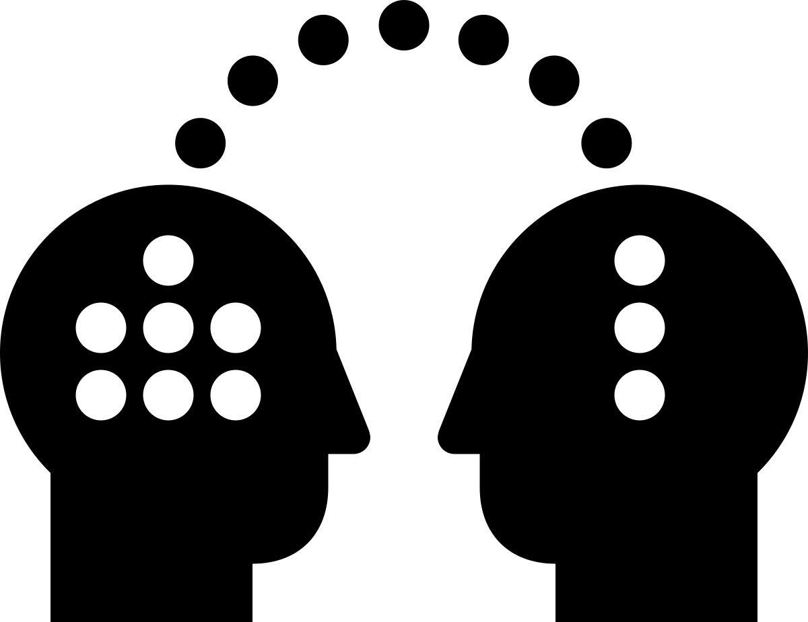
Transfer Learning with Pretrained Models
Suvarna Kadam
PhD Scholar, Department of Technology SPPU
Asst. Professor at DYPCOE Akurdi

Slide 3
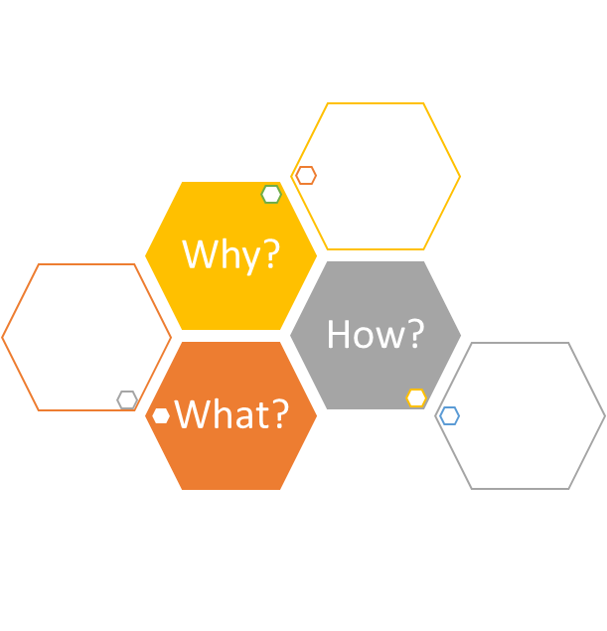
Outline
Motivation (Why to transfer knowledge?)
Existing Approaches of transfer learning
Transfer Learning in Deep Models
Train a (source) deep network or find a pretrained model
Repurpose the pretrained model for your needs
Predict with new target model
Case study for image classification with pretrained model

Slide 4
Traditional Machine Learning
Learning is hard!
Lot of data and compute!
Catastrophic Forgetting
Notes:
Knowledge is learned hard way by machines.
Simple task of telling apples & oranges apart takes lot of data and compute
Knowledge used for one task is lost if the model needs to learn new task

Slide 5

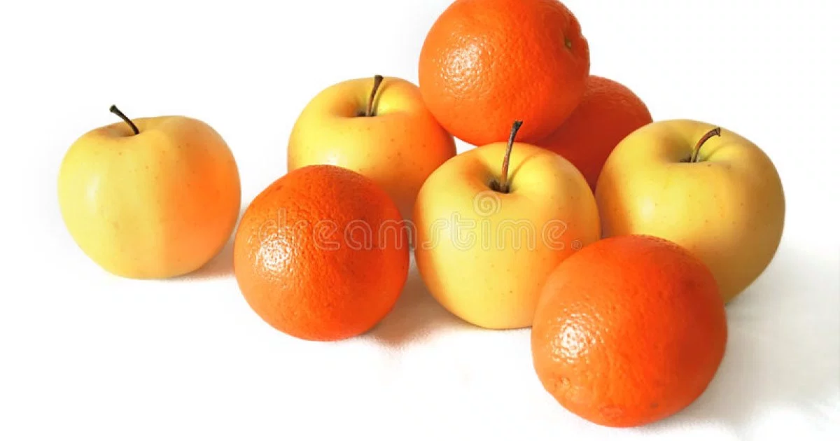
Why learning is hard for machines?
?
Notes:
Even telling apples apart from oranges is tough for ML. We can not write a simple rule that tells them apart
ML also needs someone to teach which one is apple and which is orange

Slide 6
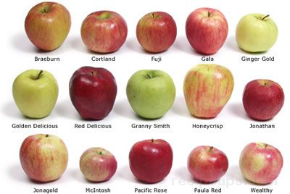
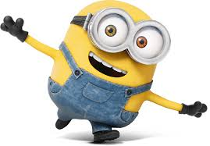
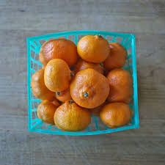
Learning from observations
Apples
Oranges
Notes:
Supervised learning or rather teaching where we teach the ML model concept of apple and orange by showing observations of apples nd oranges

Slide 7
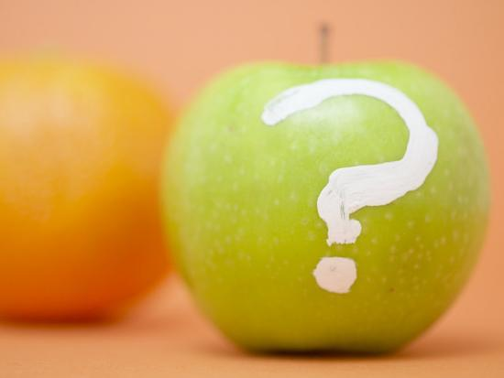
Learning from observations
Apples
Oranges
Apple/Orange?
Training
Testing

Slide 8

Traditional Machine Learning
Learning is hard!
Lot of data and compute!
Catastrophic Forgetting
Notes:
Knowledge is learned hard way by machines.
Simple task of telling apples & oranges apart takes lot of data and compute
Knowledge used for one task is lost if the model needs to learn new task

Slide 9
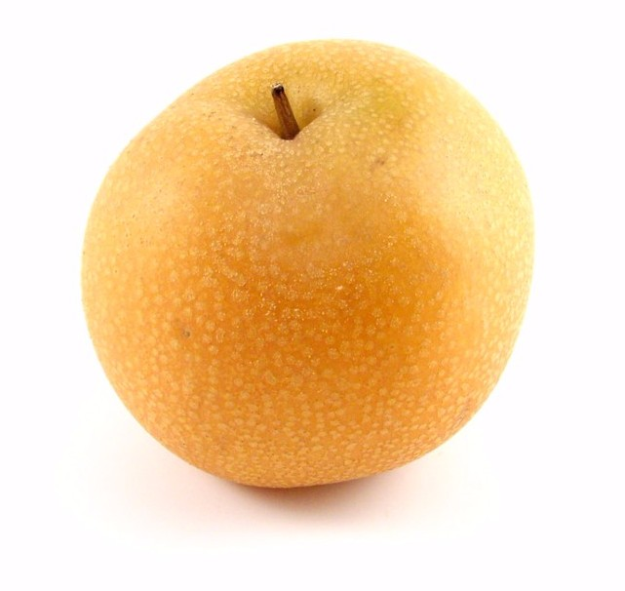
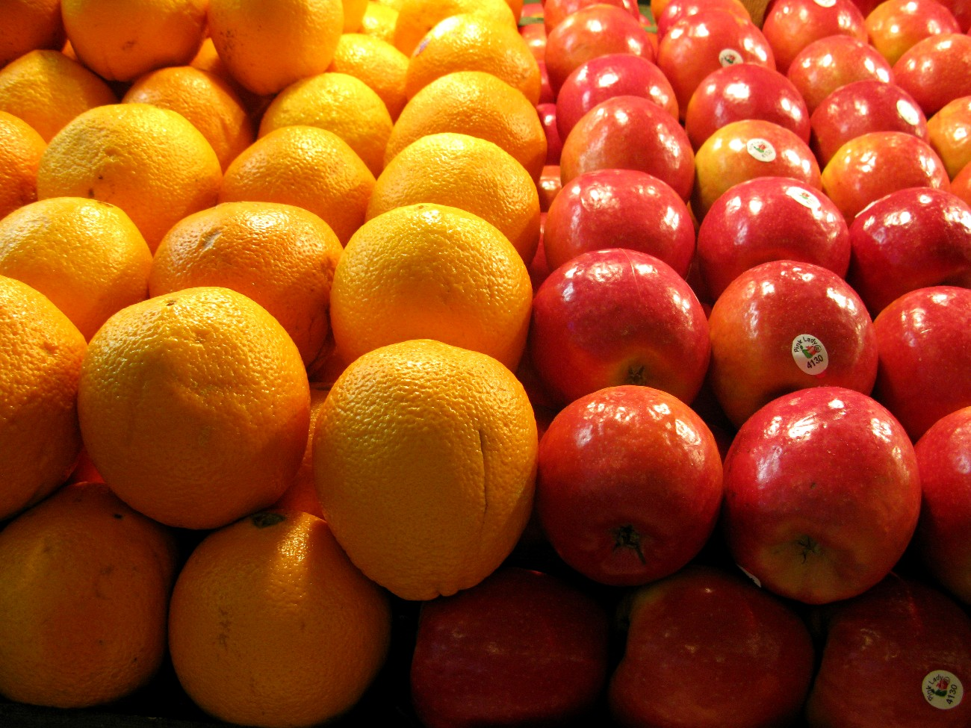
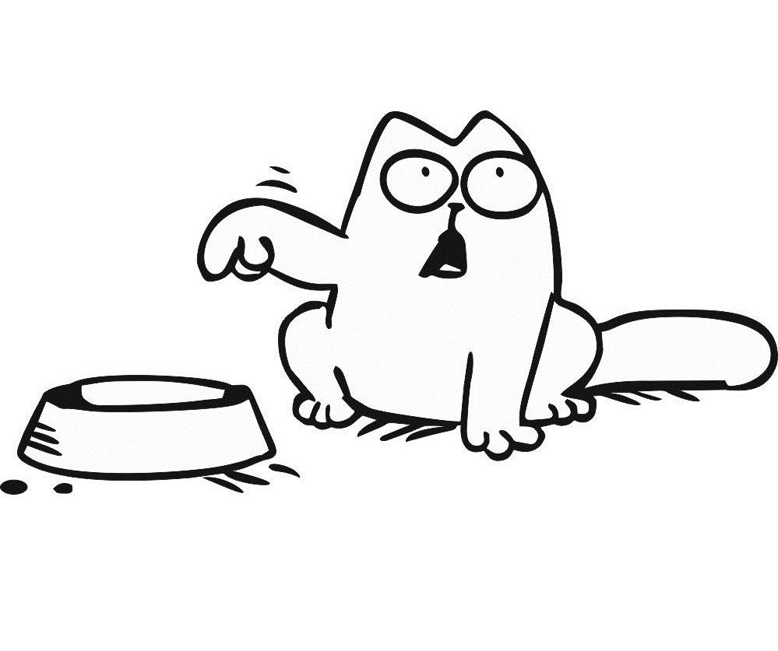
Finding Pattern
Purpose of Machine Learning - Find Patterns in Data!
But the problem is ML need lots of data & Compute to learn patterns effectively.
Give me Data!
Notes:
To handle patterns despite apparent randomness, we need a LOT of data
Unsupervised learning
Image classification is hard because of intraclass variance

Slide 10
Traditional Machine Learning
Learning is hard!
Lot of data and compute!
Catastrophic Forgetting
Notes:
Knowledge is learned hard way by machines.
Simple task of telling apples & oranges apart takes lot of data and compute
Knowledge used for one task is lost if the model needs to learn new task

Slide 11

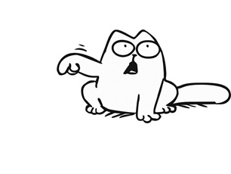
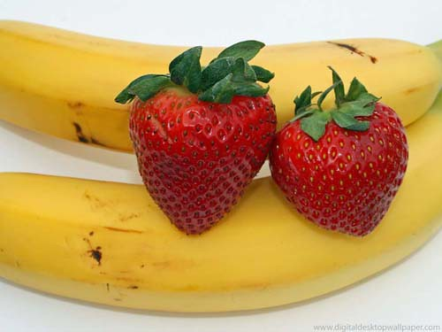
Machines have amnesia!
Machines can learn one task at a time.
But the problem is catashropic forgetting where ML models forget knowledge learned from first task while learning new task!
Apples ? Orange?
Banana ? Straberry?

Slide 12
Traditional Machine Learning
Learning is hard!
Lot of data and compute!
Catastrophic Forgetting
Notes:
Knowledge is learned hard way by machines.
Simple task of telling apples & oranges apart takes lot of data and compute
Knowledge used for one task is lost if the model needs to learn new task

Slide 13

Deep Learning has additional challenges…
Training Deep models is hard
Need lot of labelled data and compute to train
Need to experiment with architecture
Need to experiment with hyper parameters(learning rate, batch size, momentum, and weight decay)
Deep models are trained for specific task
Traditional deep models can’t multi-task
To learn new task, we need to re-train them from scratch!

Slide 14
Traditional Vs. Transfer Learning
Different Tasks
Source Tasks
Target Task
Dataset 1
Dataset 2
Dataset 3
Dataset 1
Dataset 2
Dataset 3
Learning System
Learning System
Learning System
Knowledge
Learning System
Traditional ML
Transfer Learning

Slide 15
Transfer Learning
Utilize the knowledge learned with source dataset(s) to perform a task with target dataset.
Store Knowledge
Knowledge is present in the form of weights of trained model.
Weights represent features learned about the (source) tasks
Transfer Knowledge
The learned features are reused when performing a (target) new task.
The model need not be trained from scratch
Source Tasks
Target Task
Dataset 1
Dataset 2
Dataset 3
Knowledge
Learning System
Transfer Learning

Slide 16
Two Approaches for Deep Transfer Learning
Train-Source-Models-from-scratch
Pre-trained Model Approach
Select Source Task. Select Source task with an abundance of data
Train Source Model(s). Train model rigorously to ensure that features are learned
Reuse Model. The trained model on the source task is used as the starting point for a model on the target task.
Tune Model. Optionally, the source model may need to be adapted or refined for target task.
Select Source Model. A pre-trained source model is chosen from available models.
Reuse Model. The model pre-trained model can then be used as the starting point for a model on the second task of interest. This may involve using all or parts of the model, depending on the modeling technique used.
Tune Model. Optionally, the model may need to be adapted or refined on the input-output pair data available for the task of interest.
Assumption: We have a repository of several source models.
Notes:
Many research institutions release models on large and challenging datasets that may be included in the pool of candidate models from which to choose from.
Trend started with Model Zoo Project by Berkley

Slide 17
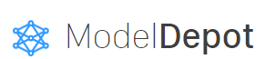



Public Repositories of Pretrained Models
Pretrained Model Repository
Caffe Model Zoo
Keras Pretrained Models
Torch Vision Models
Model Depot
Tensorflow Hub

Slide 18
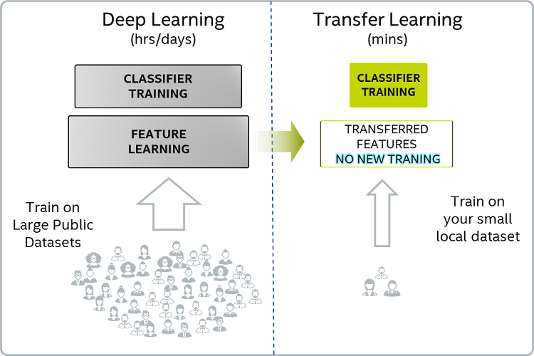
Deep Transfer Learning
Image Credit: https://www.freecodecamp.org/news/asl-recognition-using-transfer-learning-918ba054c004/
Notes:
Features can be learned better on LARGE datasets like ImageNet

Slide 19
Repurposing Deep Model for target task

Slide 20
Image classification with pretrained model
Target Task : Image Classification
Deep Models : Convolutional Neural Networks
Source Datasets : ImageNet, Open Images,The Street View House Numbers (SVHN)
Notes:
An example

Slide 21
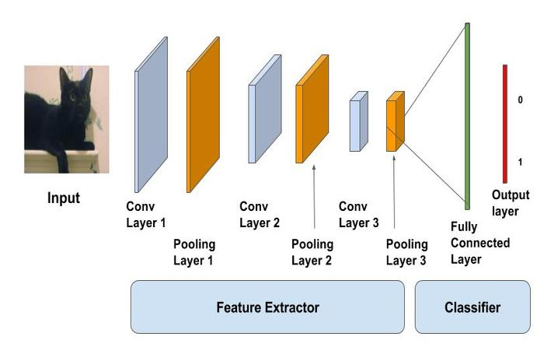
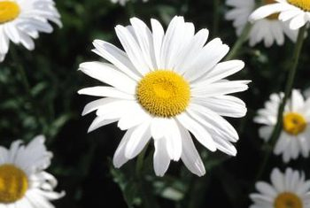
Convolutional Base
With Frozen layers
Fine Tuning for Target Task

Slide 22

Frozen Layers
Retrained Layers

Slide 23

Frozen Layers
Finetuning with target dataset

Slide 24
Image Classification
Source Dataset: ImageNet
Target Dataset: Flowers
Task: Classification
https://colab.research.google.com/drive/1fbz7RSho0OjSVysFk0Qu1m8Bpe6MbzZk

Slide 25
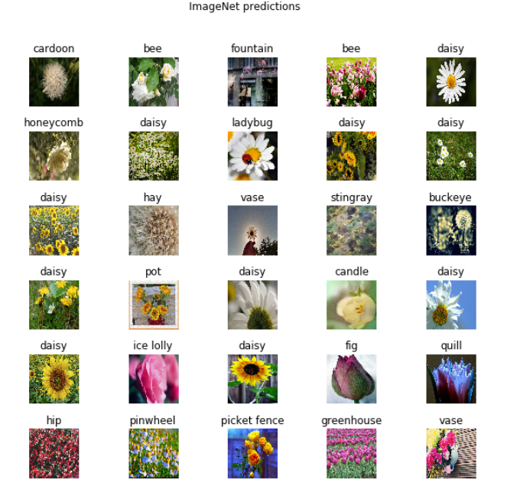
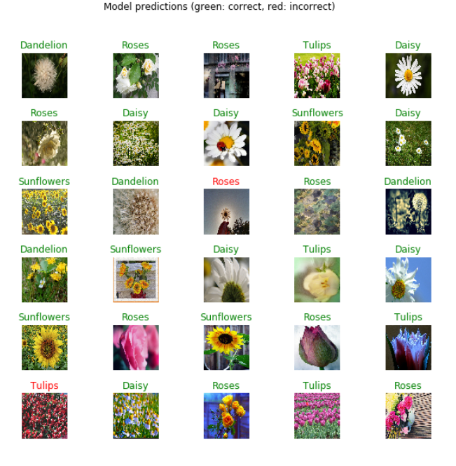

Slide 26
Text Classification
Source Dataset: Google News
Target Dataset: imdb
Task: Text Classification (Sentiment Analysis)
https://colab.research.google.com/drive/14IzmGkNTTwCpzf9UNyaVDXK6tE3jcWqQ

Slide 27
Summary
Transfer Learning with pretrained models democratises Deep Learning to some extent
Anyone with small dataset and low compute can benefit the heavy duty Deep learning machinery
Applications range across modalities – Image, Text and Speech

Slide 28
Thank You!

